Slide 1
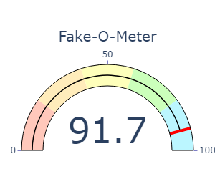
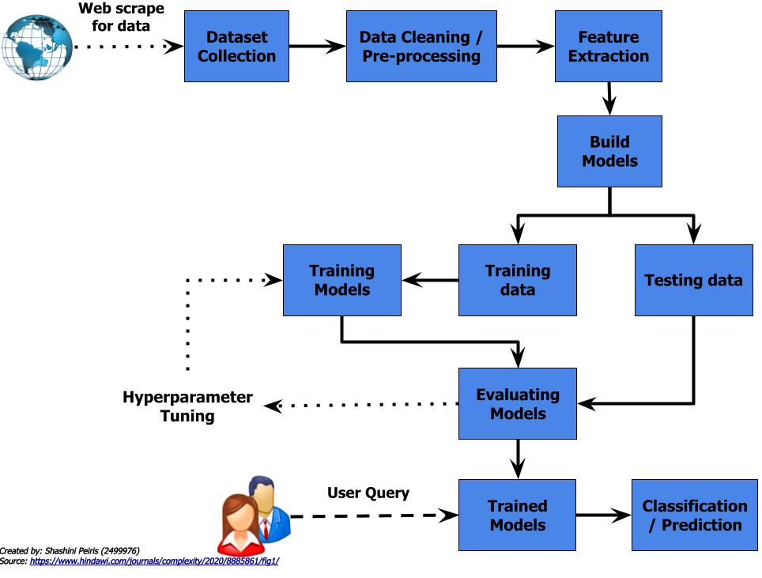

Finding Fake News
Shashini Peiris
Advisor: Dr. Craig Ramsay
The fake news term originally refers to false and often sensationalist information disseminated under the guise of relevant news.
How to detect fake news:
False information in it
Writing style of the article
Propagation pattern of articles
Credibility of its source
Approaches
Language approach
Topic-agnostic approach
Machine learning approach
Knowledge-based approach
Hybrid approach
Feature Extraction
Tfidf Vectorizer
Count Vectorizer
Classifiers
Naïve Bayes
Logistic Regression
SVM
SGD
Random Forest
Passive Aggressive

